Slide 1
Software Product Management Principles of UX design
Nandagopal Govindan

Slide 2
Contents
Dimensions of Usability (Jakob Nielsen)
Steps for UI design
Different aspects of UX design
Evaluating UX – Nielsen’s heuristics

Slide 3
Introduction
Have you come across User interfaces that exhibit the following:
Unintuitive and hard to use.
You can't find what you're looking for
You're not clear what to do next.

Slide 4
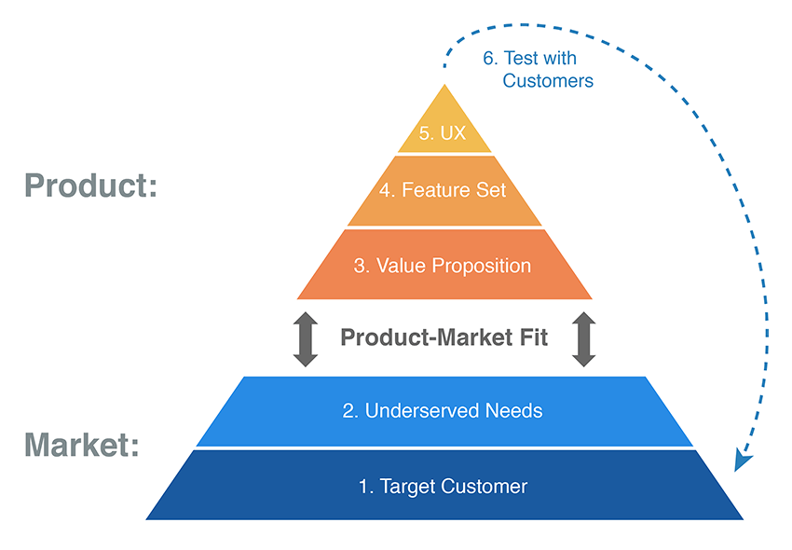
Introduction
One way to evaluate UX is to consider how much it helps or hinders the functionality / features in realizing the value proposition (the desired customer benefits) (Product – Market fit pyramid)

Slide 5
Dimensions of Usability
Learnability: How easy is it for users to accomplish basic tasks the first time they encounter the design?
Efficiency: Once users have learned the design, how quickly can they perform tasks?
Memorability: When users return to the design after a period of not using it, how easily can they re-establish proficiency?
Errors: How many errors do users make, how severe are these errors, and how easily can they recover from the errors?
Satisfaction: How pleasant is it to use the design?

Slide 6
Dimensions of Usability
Consider the following:
Learnability: How quickly can you learn to use these - washing machine, Gmail, online banking
Efficiency: How efficiently can you accomplish your task using these – MS Word, 50 process templates to choose from in Kissflow
Memorability: How long does it take to use these when you return again to use them - Airport kiosk to print boarding pass, Movie theatre kiosk to print ticket
Errors: How many errors do you make while buying a product on Flipkart?
Satisfaction: How pleasant was your experience using MakeMyTrip.com?

Slide 7
Exercise: Give examples
Dimension | Good product example
Learnability
Efficiency
Memorability
Error
Satisfaction

Slide 8
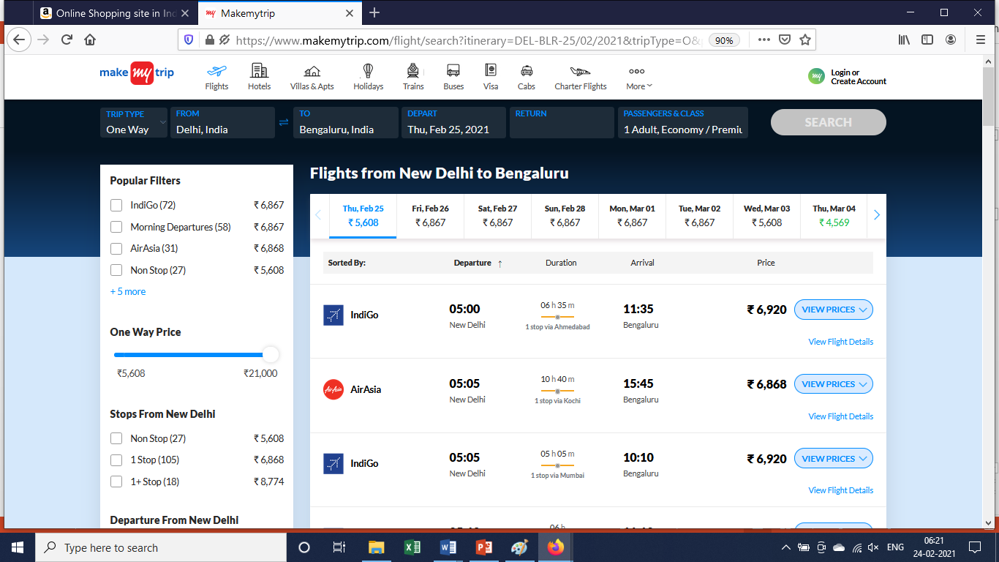
Exercise
Comment on the “Efficiency” dimension of booking an flight ticket in MakeMyTrip.com

Slide 9
Basic steps
Design the overall structure
Consider the different scenarios (use cases)
Design navigation & screens for each scenario

Slide 10
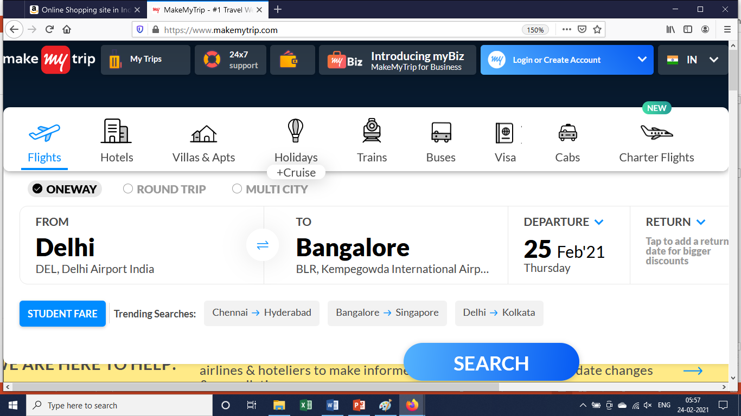
Example: Overall structure

Slide 11
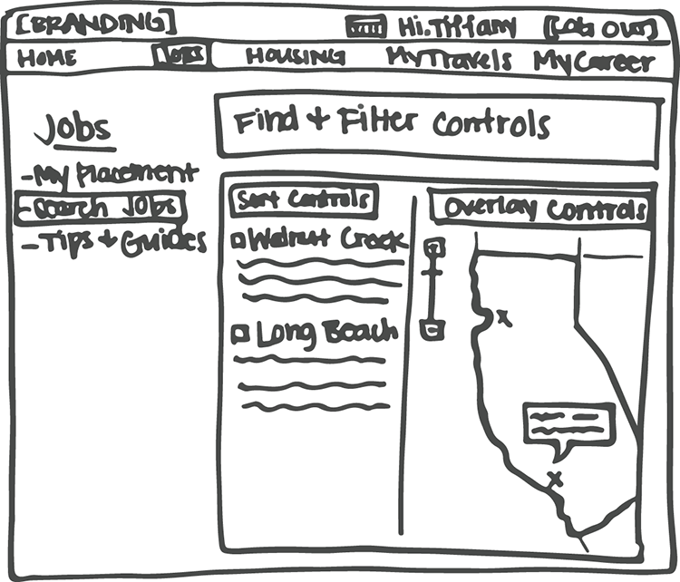
Example: Sketch of overall structure
Portal for travelling nurses
Show different areas using rectangles
This is an iterative process

Slide 12
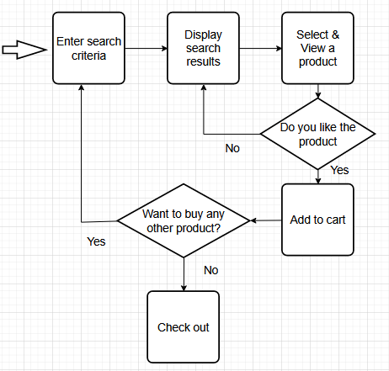
Example: Scenario: Searching & selecting products to buy

Slide 13
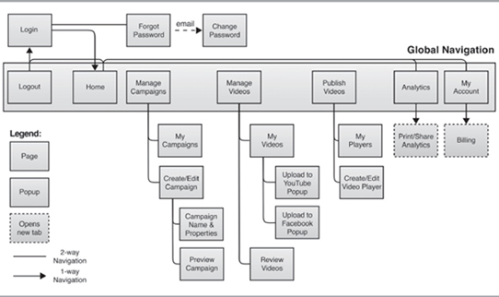
Example: Navigation

Slide 14
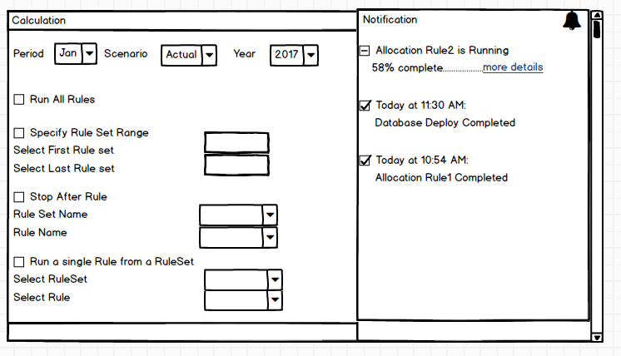
Example: Screen design

Slide 15
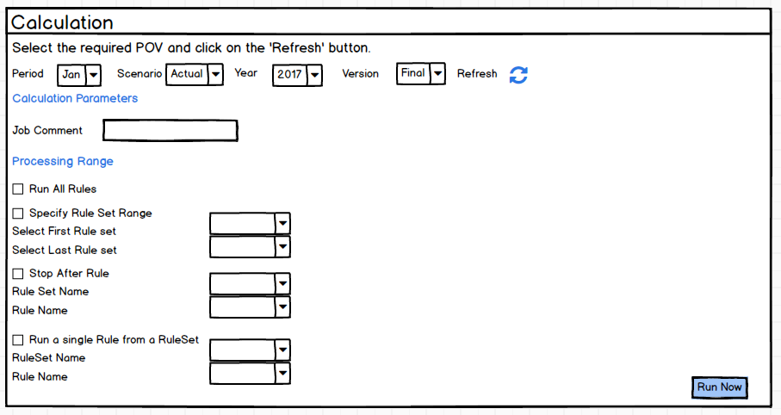
Example: Screen design

Slide 16
Ideal sequence for design
Sketch => Wireframe => Lo-fi Prototype => Hi-fi Prototype => Code

Slide 17
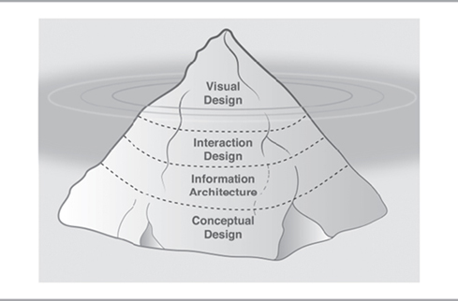
Different aspects of creating UX
Conceptual design
Information architecture
Interaction design
Visual design

Slide 18
Conceptual design
Should resonate with how the users think (Mental model)
Examples:
Quicken used checkbook as a metaphor, which customers found very intuitive.
Uber's conceptual design was to show users the location of nearby cars in real time:
Tally: User’s language not Accountant’s language
MakeMyTrip: Steps to book ticket match users expectations
Need to understand users and their goals (personas)
How tech savvy is the customer?
What is the age?
What is the environment in which he will be using the product (in a car while driving, in a noisy factory)

Slide 19
Exercise: Conceptual design
Comment on the conceptual design of the “Funds transfer” feature of your bank’s online banking software

Slide 20
Information architecture
Deals with how you organize information on the screen
Findability is a key measure
Organize features, label them in a way that is easy to understand
Organize in sections and screens within sections (Site map)
Global navigation pattern

Slide 21
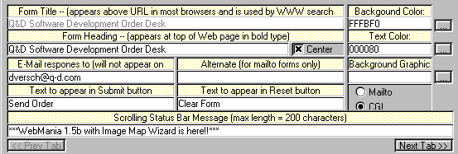
Information architecture: Example of bad design
How you like this screen design?

Slide 22
Exercise: Info architecture
Comment on the “Findability” aspect of your bank’s online banking software
How easy or difficult it is to find the following features:
Order cheque book
Block debit card
Access Form 16

Slide 23
Interaction design
Deals with:
What actions can the user take at each step, and how will the product respond?
How will the user interact: click, hover, drag, type, tap, swipe, etc.
What navigations needs to be provided?
Depicting the state, such as - Product selected, checkout, payment
How does the product provide feedback?
Error messages,
confirmation,
acknowledgement for pressing a button,
wait indicators (hour glass),
progress bar,
‘you are here’ indicator in a multi step process
Which product you have used that gives good feedback?

Slide 24
Customer journey mapping (different touch points)
A customer journey is the end-to-end process that a customer goes through in order to complete a task over time
Customers interact with an application using multiple devices – laptop, smart phone, kiosk – and in multiple ways – email, browser, sms. (touch points)
Example: Airline travel
Book ticket using laptop
On day of journey, the airline sends me a notification to check in
I show my phone boarding pass at gate
I print boarding pass on kiosk
If there’s a flight delay, I’m updated immediately by text message or email.

Slide 25
Exercise: Customer journey mapping
Can you give example of customer journey mapping for Customer complaint of lost credit card?

Slide 26
Visual design (Graphic design)
Deals with:
Colour (highlight, borders, title)
Hierarchies (Heading, sections, …)
Brand personality (Company logo)
Fonts
Images (AirBnB)
Icons (Save, Edit, …)
Style guide for consistent design

Slide 27
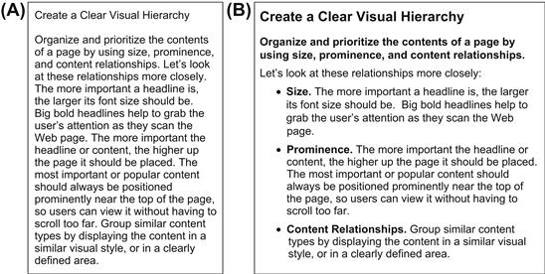
Visual design: Hierarchy

Slide 28
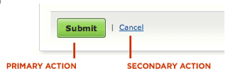
Evaluating design: Nielsen’s heuristics
Simple & Natural dialogue – minimize concepts, match user’s mental model
Speak user’s language – avoid codes such as 44 for UK, 1 for US, avoid technical terms such as memory overflow
Minimize user memory load - Use menus and drop downs
Consistency – Example menu items across Word, Excel, Powerpoint
Feedback – Confirmation of action, Progress indicator
User control & freedom – Example Home, Back, Undo, Redo
Clearly marked exits – Cancel, Logout
Shortcuts – Ex. Word shows last files opened, prefill preferences, default values
Good error messages – Precise and helpful: Can not open file Chapter 5 because it is not on disk”. It is possible that the file has been moved to new directory or might have been renamed”
Prevent errors – Example Drop down values, Calendar to select date, Describe the format ex. dd-mmm-yyyy 2-Oct-2048, Make primary action prominent
Help & Documentation – Task oriented search
Revised & Excellent: https://www.nngroup.com/articles/ten-usability-heuristics/

Slide 29
Summary
We looked at:
5 dimensions of Usability: Learnability, Efficiency, Memorability, errors & Satisfaction
4 aspects of design: Conceptual, Information architecture, Interaction design, Visual design
Evaluation heuristics of Nielsen

Slide 30
Question
What are the key learnings from this session?

Slide 31
Appendix

Slide 32
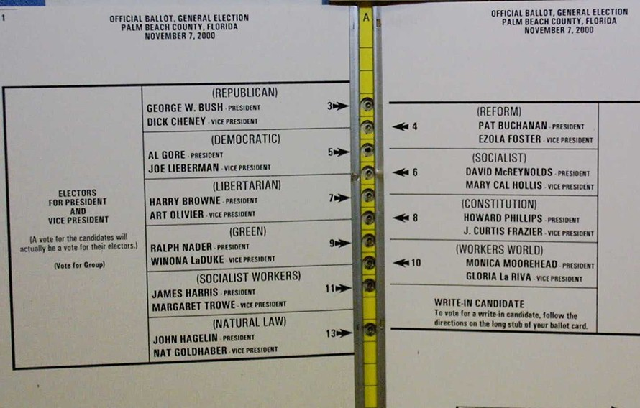
Information architecture:
Example of poor organization
Al Gore from the Democratic Party, lost many thousands of votes, which instead went to the Reform Party.

Slide 33
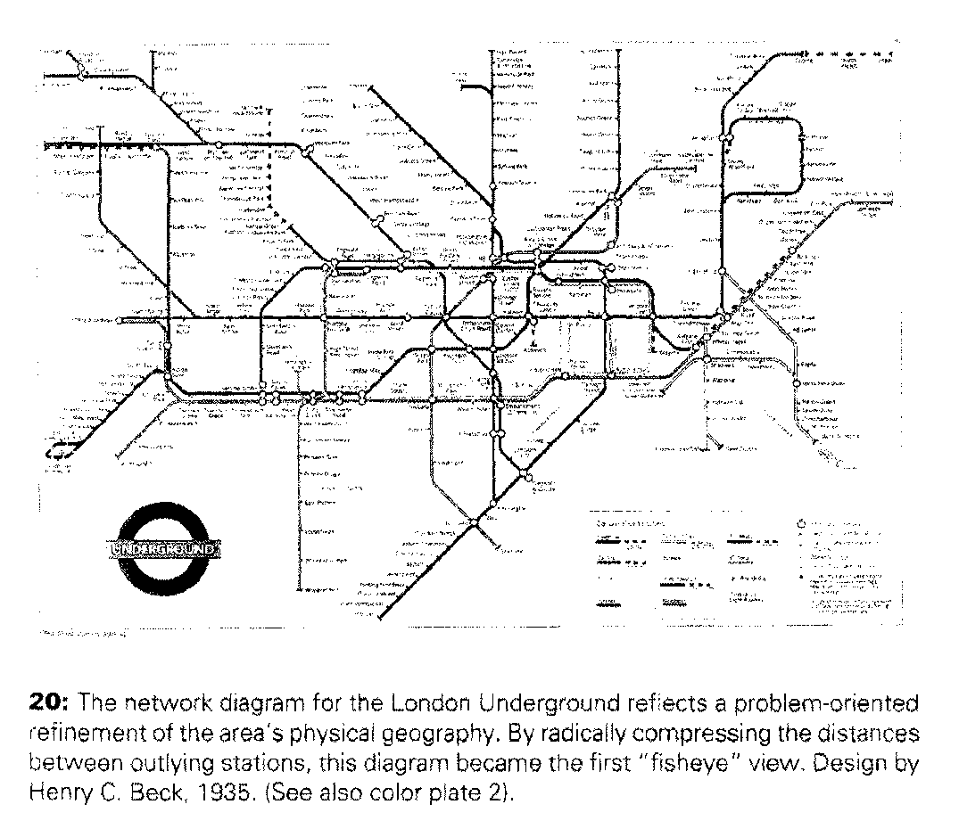
Elegance & Simplicity

Slide 34
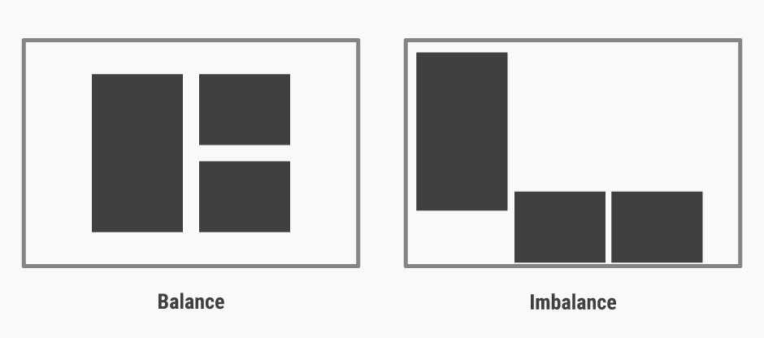
Balance
Source: https://www.interaction-design.org/literature/topics/visual-design

